Slide 1
Cell Processor Programming
Patterns in aligned prime numbers
Notes:
Hello
Purpose:
aim for sth practical, common and widely spread,
Perfectly aimed by PS3
Video Encoding:
standardized on the decoding side
Very complex
Open source, time and space critical
Based on :
H.264 encoding on the IBM Cell/B.E. Processor
Shrivathsa Bhargav University of Colombia

Slide 2
Outline
Idea
Design
  Challenges
  Algorithm
Testing
Performance
Code
  mfc_get & mfc_put
  2 D arrays
  reload
Results
  Images
  Statistics

Slide 3

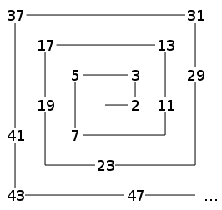
Idea
→

Slide 4
Design Challenges
Primality test
  Sieve of Eratosthenes
  Agrawal-Kayal-Saxena primality test
  Miller-Rabin primality test
Line detection
  Edge detection
  Statistics
Storage
Concurrency

Slide 5
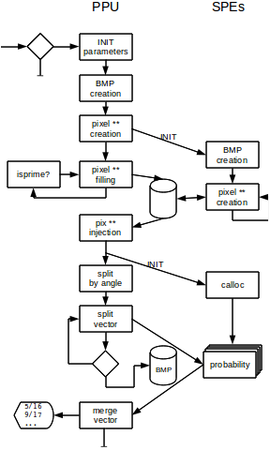
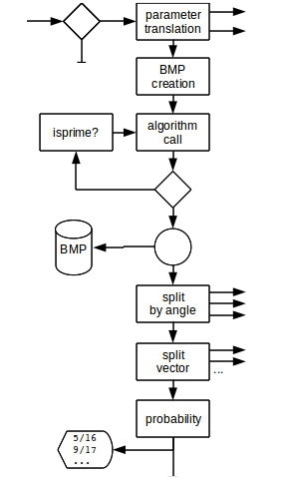
Design

Slide 6
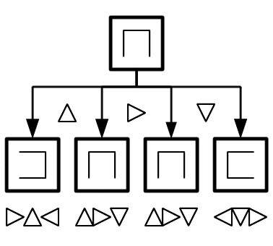
Algorithm

Slide 7
Performance

Slide 8
Testing
./ulam [250, 600, 2100, 5250] 1 - all algorithms, no file safe
cumulative self self total
time seconds seconds calls s/call s/call name
21.49 1.76 1.76 3 0.59 0.59 bmp_malloc_pixels
13.92 2.90 1.14 3 0.38 0.38 prob45deg
13.68 4.02 1.12 3 0.37 0.37 prob0deg
12.94 5.08 1.06 3 0.35 0.35 prob135deg
9.22 5.83 0.76 52261913 0.00 0.00 bmp_set_pixel
6.84 6.39 0.56 3 0.19 0.19 prob90deg
5.37 6.83 0.44 1 0.44 0.67 spiral
5.31 7.27 0.43 1 0.43 0.58 hilbert
4.52 7.64 0.37 49133184 0.00 0.00 markprime
3.79 7.95 0.31 main
1.71 8.09 0.14 49144720 0.00 0.00 bmp_get_height
1.04 8.18 0.09 1 0.09 0.13 ncurve
0.18 8.19 0.01 is_big_endian
0.00 8.19 0.00 11537 0.00 0.00 bmp_get_width
0.00 8.19 0.00 6 0.00 0.00 uint32_pow
0.00 8.19 0.00 3 0.00 0.59 bmp_create
0.00 8.19 0.00 3 0.00 0.00 bmp_create_standard_color_table
0.00 8.19 0.00 3 0.00 0.00 bmp_malloc_colors
0.00 8.19 0.00 3 0.00 1.29 probs
0.00 8.19 0.00 1 0.00 0.00 bmp_destroy
0.00 8.19 0.00 1 0.00 0.00 bmp_free_colors
0.00 8.19 0.00 1 0.00 0.00 bmp_free_pixels

Slide 9
mfc_get & mfc_put
void getfrom(uint64_t what, uint64_t where, long int size){
if(size<=4000){
mfc_get(what, where, size, 0, 0, 0);
mfc_read_tag_status_all();
else {
getfrom(what, where , size/2);
getfrom((what)+size/2, (where)+size/2 , size/2);}
}

Slide 10
Two dimensional arrays
Allocation:
pixs=calloc(addr->bmpsize, sizeof(rgb_pixel_t *));
for(i=0; i<addr->bmpsize; i++) {
pixs[i]=malloc(addr->bmpsize*sizeof(rgb_pixel_t));}
First dimension:
pixs=calloc(addr->bmpsize, sizeof(rgb_pixel_t *));
for(i=0; i< addr->retaddr; i++){
mfc_get(pixs[i], addr->retaddr, sizeof(rgb_pixel_t *), 0, 0, 0);
mfc_read_tag_status_all();}
Next dimensions:
reload(addr);

Slide 11
Reload
void reload(INIT * addr){
mfc_get(addr, addr->this, sizeof(BMPINIT), 0, 0, 0);
mfc_read_tag_status_all();
// if the needed data is updated:
if(count<=addr->count) {
//get Data
getfrom(inpix
, (int) pixs[count]
, addr >primzsize*(sizeof(rgb_pixel_t)), 0, 0, 0);
count++;
done=0;
todo=addr->primzsize;
}
else reload(addr); // if not: try again
}

Slide 12
Result

Slide 13


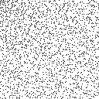
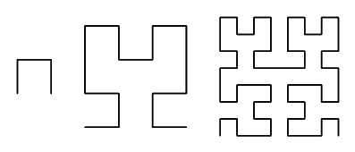
Meta result

Slide 14
Statistics – Ulam spiral

Slide 15
Statistics – Hilbert curve

Slide 16
Satistics - N curve

Slide 17
please ask your questions
and add your comments

